Slide 1
Sand as media of Art
Physical simulation of granular materials for facilitating artist interaction
Nafees Ahmed

Slide 2
Motivation
Sand animation is a performance art technique in which an artist tells stories by creating animated images with sand.
Artists like Ilana Yahav , Kseniya Simonova , Su Dabao , Joseph Valerio are bringing this amazing performance art media in front of the world and making it more and more famous everyday.

Slide 3
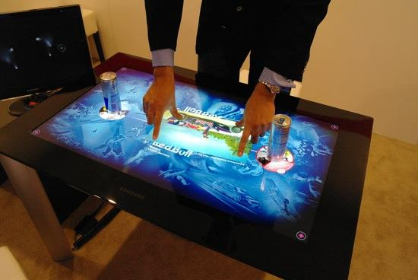
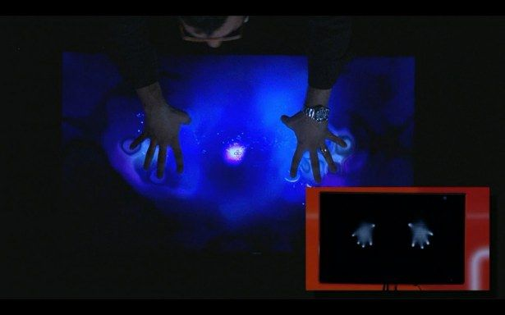
Motivation
Introduction of multi touch user interfaces and screens is providing the opportunity of bringing this beautiful art media into the digital world.
Example of multi-touch workspaces Microsoft Surface

Slide 4
Challenges
Allowing the artist to use his both hand , fingers , palms in articulated way to produce almost infinitely many different ways of interacting with the virtual sand.
Simulating the sand granules in a visually accurate manner that can represent both the appearance and the physical interaction of real art-sand granules.

Slide 5
Physics of Sand
What are the physical properties of sand?
What makes it different than other materials?
What mathematical equation can properly explain physical behavior of sand?
Sand falls into the more general category of granular materials.

Slide 6
Physics of Sand
“Granular solids, liquids, and gases” Heinrich M. Jaeger, Sidney R. Nagel , Robert P. Behringer Reviews of Modern Physics, Vol. 68, No. 4, October 1996

Slide 7
Physics of Sand
They are large conglomerations of discrete macroscopic particles.
If they are non-cohesive, then the forces between them are only repulsive so that the shape of the material is determined by external boundaries and gravity.
If the grains are dry, any interstitial fluid, such as air, can often be neglected in determining many, but not all, of the flow and static properties of the system.

Slide 8
Yet despite this seeming simplicity, a granular material behaves differently from any of the other familiar forms of matter—solids, liquids, or gases—and should therefore be considered an additional state of matter in its own right.

Slide 9
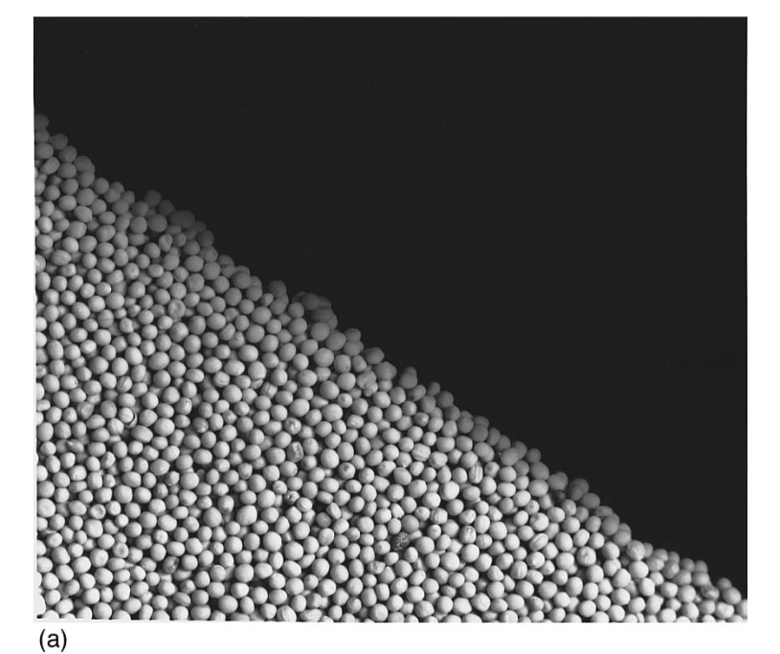
A sand pile at rest with a slope lower than the angle of repose behaves like a solid.

Slide 10
At rest state, the pressure at the bottom of sand column is constant given enough depth.
This allows the construction of hour glass with sand rather than liquids.

Slide 11
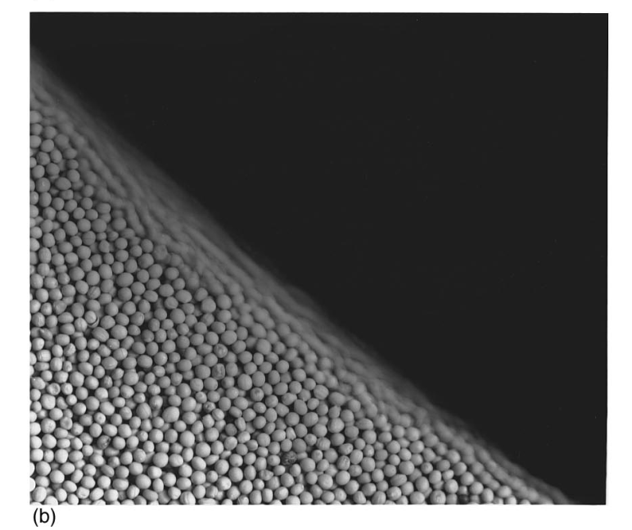
If the pile is titled beyond a specific angle, the granules start to flow, but unlike liquid the flow is confined within the boundary particles only.

Slide 12
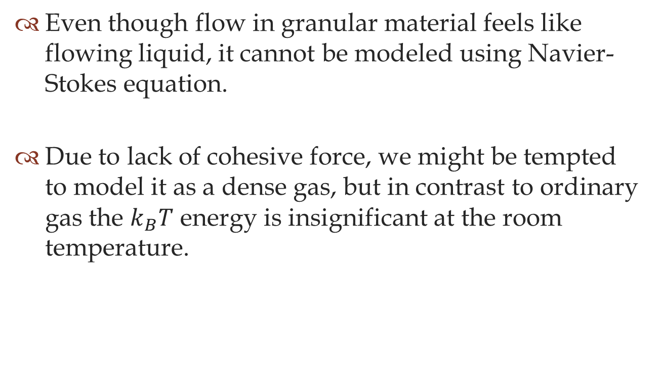
Even though flow in granular material feels like flowing liquid, it cannot be modeled using Navier-Stokes equation.
Due to lack of cohesive force, we might be tempted to model it as a dense gas, but in contrast to ordinary gas the $k_{B}T$ energy is insignificant at the room temperature.

Slide 13
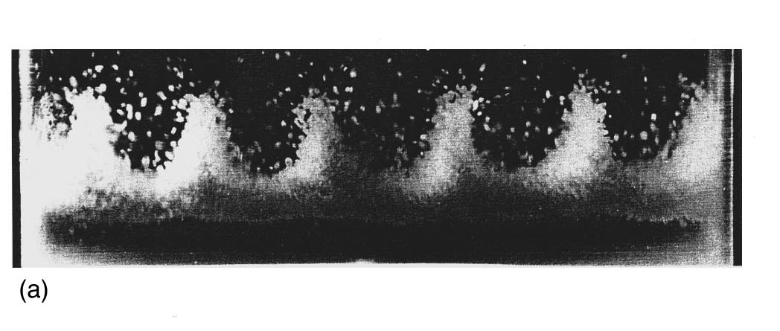

Slide 14
Granular Material Simulations
Steps common to all approaches,
Identify an application paradigm.
Select a subset of sand behavior relevant to the application.
Find the mathematical model that best describes the physical behavior.
Find a optimal implementation of the model.
Provide a way of rendering the sand model.

Slide 15
Granular Material Simulations
X. Li and J. M. Moshell. “Modeling soil: Realtime dynamic models for soil slippage and manipulation.” proceedings of SIGGRAPH ’93, pages 361–368, 1993.
B. Chanclou, A. Luciani, and A. Habibi. “Physical models of loose soils dynamically marked by a moving object. ” Computer Animation, pages 27–35, 1996.
R. W. Sumner, J. F. O’Brien, and J. K. Hodgins. “Animating sand, mud, and snow.” Computer Graphic Forum, 18:3–15, Mar. 1999.
Y.L Zeng , C. I. Tan et al “A Momentum Based Deformation System for Granular Material” Computer Animation and Virtual Worlds - CASA 2007 Volume 18 Issue 4-5, September 2007
Miller, G. and Pearce, A. “Globular dynamics: A connected particle system for animating viscous fluids.” Computers and Graphics, 13(3):305–309, 1989.
N. Bell, Y. Yu, and P. J. Mucha. “Particle-based simulation of granular material.” ACM SIGGRAPH/Eurographics Symposium on Computer Animation, 2005.
Zhu, Y. and Bridson, R. “Animating sand as a fluid.” ACM SIGGRAPH 2005 Papers, pages 965–972. ACM Press, New York, NY, USA, 2005.
Monaghan, J. J. “Smoothed Particle Hydrodynamics. “ Annual review of astronomy and astrophysics, 30(A93-25826 09-90):543–574, 1992.
Lenaerts, T. and Dutr´e, P. “Mixing fluids and granular materials.” Computer Graphics Forum, 28(2):213–218, 2009b.
Aldu´an, I., Tena, ´A., and Otaduy, M. A. “Simulation of high-resolution granular media.” In Proc. of Congreso Espa˜nol de Inform´atica Gr´afica. 2009.
K. Onoue and T. Nishita. “An interactive deformation system for granular material.” Computer Graphics Forum, 24(1):51–60, Mar. 2005.
K. Onoue and T. Nishita. “Virtual sandbox.” Proceedings of the 11th Pacific Conference on Computer Graphics and Applications, pages 252–259, 2003.
Rungjiratananon, W., Szego, Z., Kanamori, Y., and Nishita, T. “Real-time animation of sand-water interaction”. In Computer Graphics Forum (Pacific Graphics 2008), volume 27, pages 1887–1893. 2008.
Pla-Castells, M., Garc´ıa-Fernandez, I., and Martinez-Dura, R. J. “Physically based interactive sand simulation.” In Mania, K. and Reinhard, E., editors, Eurographics 2008 - Short Papers, pages 21–24. 2008.

Slide 16
Height Field
Particle Based
Continuum
1990
MP89
M92
LM93
CLH96
SBH99
2000
ON03
BYM05
ZB05
ZT07
PGM08
RSKN08
ATO09
LD09
2010

Slide 17
Height Field
Particle Based
Continuum
1990
MP89
M92
LM93
CLH96
SBH99
2000
ON03
BYM05
ZB05
ZT07
PGM08
RSKN08
ATO09
LD09
2010
“Modeling soil: Realtime dynamic models for soil slippage and manipulation.” X. Li and J. M. Moshell. proceedings of SIGGRAPH ’93, pages 361–368, 1993.

Slide 18
Height Field
Particle Based
Continuum
1990
MP89
M92
LM93
CLH96
SBH99
2000
ON03
BYM05
ZB05
ZT07
PGM08
RSKN08
ATO09
LD09
2010
“Physical models of loose soils dynamically marked by a moving object. ”
B. Chanclou, A. Luciani, and A. Habibi. Computer Animation, pages 27–35, 1996.

Slide 19
Height Field
Particle Based
Continuum
1990
MP89
M92
LM93
CLH96
SBH99
2000
ON03
BYM05
ZB05
ZT07
PGM08
RSKN08
ATO09
LD09
2010
“Animating sand, mud, and snow.”
R. W. Sumner, J. F. O’Brien, and J. K. Hodgins. Computer Graphic Forum, 18:3–15, Mar. 1999.

Slide 20
Height Field
Particle Based
Continuum
1990
MP89
M92
LM93
CLH96
SBH99
2000
ON03
BYM05
ZB05
ZT07
PGM08
RSKN08
ATO09
LD09
2010
“Virtual sandbox.”
K. Onoue and T. Nishita. Proceedings of the 11th Pacific Conference on Computer Graphics and Applications, pages 252–259, 2003.

Slide 21
Height Field
Particle Based
Continuum
1990
MP89
M92
LM93
CLH96
SBH99
2000
ON03
BYM05
ZB05
ZT07
PGM08
RSKN08
ATO09
LD09
2010
“A Momentum Based Deformation System for Granular Material”
Y.L Zeng , C. I. Tan et al Computer Animation and Virtual Worlds - CASA 2007 Volume 18 Issue 4-5, September 2007 .

Slide 22
Height Field
Particle Based
Continuum
1990
MP89
M92
LM93
CLH96
SBH99
2000
ON03
BYM05
ZB05
ZT07
PGM08
RSKN08
ATO09
LD09
2010
“Globular dynamics: A connected particle system for animating viscous fluids.”
Miller, G. and Pearce, A. Computers and Graphics, 13(3):305–309, 1989.

Slide 23
Height Field
Particle Based
Continuum
1990
MP89
M92
LM93
CLH96
SBH99
2000
ON03
BYM05
ZB05
ZT07
PGM08
RSKN08
ATO09
LD09
2010
“Particle-based simulation of granular material.”
N. Bell, Y. Yu, and P. J. Mucha. ACM SIGGRAPH/Eurographics Symposium on Computer Animation, 2005.

Slide 24
Height Field
Particle Based
Continuum
1990
MP89
M92
LM93
CLH96
SBH99
2000
ON03
BYM05
ZB05
ZT07
PGM08
RSKN08
ATO09
LD09
2010
“Real-time animation of sand-water interaction”.
Rungjiratananon, W., Szego, Z., Kanamori, Y., and Nishita, T. In Computer Graphics Forum (Pacific Graphics 2008), volume 27, pages 1887–1893. 2008.

Slide 25
Height Field
Particle Based
Continuum
1990
MP89
M92
LM93
CLH96
SBH99
2000
ON03
BYM05
ZB05
ZT07
PGM08
RSKN08
ATO09
LD09
2010
“Smoothed Particle Hydrodynamics. “ Monaghan, J. J. Annual review of astronomy and astrophysics, 30(A93-25826 09-90):543–574, 1992

Slide 26
Height Field
Particle Based
Continuum
1990
MP89
M92
LM93
CLH96
SBH99
2000
ON03
BYM05
ZB05
ZT07
PGM08
RSKN08
ATO09
LD09
2010
“Animating sand as a fluid”
Zhu, Y. and Bridson, R. .” ACM SIGGRAPH 2005 Papers, pages 965–972. ACM Press, New York, NY, USA, 2005.

Slide 27
Height Field
Particle Based
Continuum
1990
MP89
M92
LM93
CLH96
SBH99
2000
ON03
BYM05
ZB05
ZT07
PGM08
RSKN08
ATO09
LD09
2010
“Mixing fluids and granular materials.”
Lenaerts, T. and Dutr´e, P. Computer Graphics Forum, 28(2):213–218, 2009b.

Slide 28
Height Field
Particle Based
Continuum
1990
MP89
M92
LM93
CLH96
SBH99
2000
ON03
BYM05
ZB05
ZT07
PGM08
RSKN08
ATO09
LD09
2010
“Simulation of high-resolution granular media.”
Aldu´an, I., Tena, ´A., and Otaduy, M. A. In Proc. of Congreso Espa˜nol de Inform´atica Gr´afica. 2009.

Slide 29
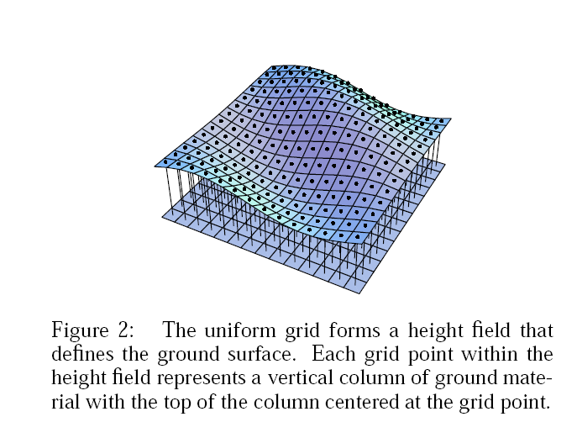
Height Field Approach

Slide 30
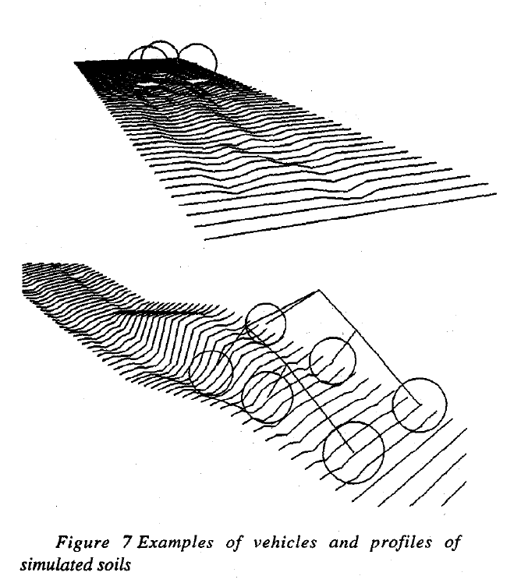
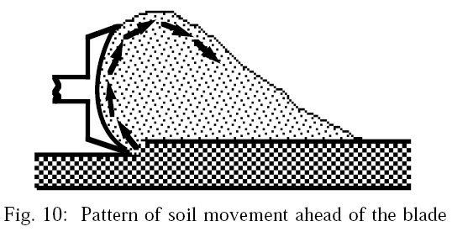
[LM93]
[CLH96]

Slide 31
“Animating sand, mud, and snow.”
R. W. Sumner, J. F. O’Brien, and J. K. Hodgins. Computer Graphic Forum, 18:3–15, Mar. 1999.

Slide 32
Collision with rigid object.
For each column, a ray is cast from the bottom of the column through the vertex at the top.
If ray intersects rigid surface before the field height then there is a collision.
Computation cost in collision is reduced by partitioning the polygons of rigid body models using an axis aligned bounding box hierarchy.

Slide 33
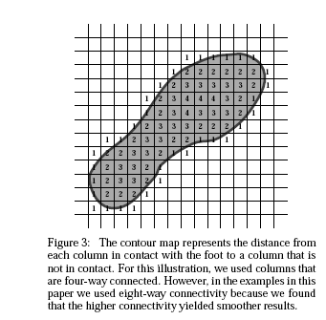
Displacement
Using vertex coloring algorithm, simulation computes a contour map with the distance from each column that has collided with the object to the closest column that has not collided. And also the depth of displacement.

Slide 34
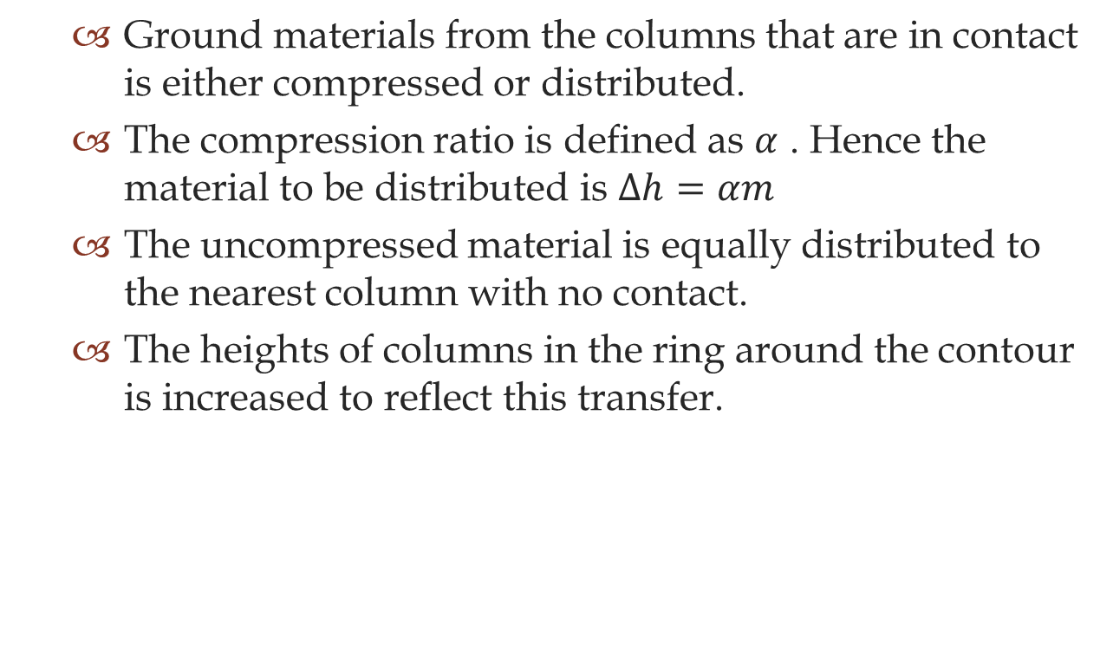
Ground materials from the columns that are in contact is either compressed or distributed.
The compression ratio is defined as $α$ . Hence the material to be distributed is $Δh=αm$
The uncompressed material is equally distributed to the nearest column with no contact.
The heights of columns in the ring around the contour is increased to reflect this transfer.

Slide 35
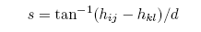
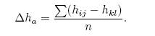
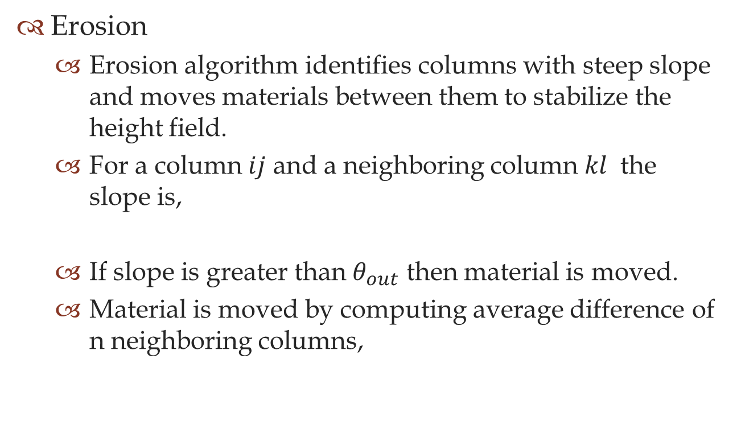
Erosion
Erosion algorithm identifies columns with steep slope and moves materials between them to stabilize the height field.
For a column $ij$ and a neighboring column $kl$ the slope is,
If slope is greater than $θ_{out}$ then material is moved.
Material is moved by computing average difference of n neighboring columns,

Slide 36
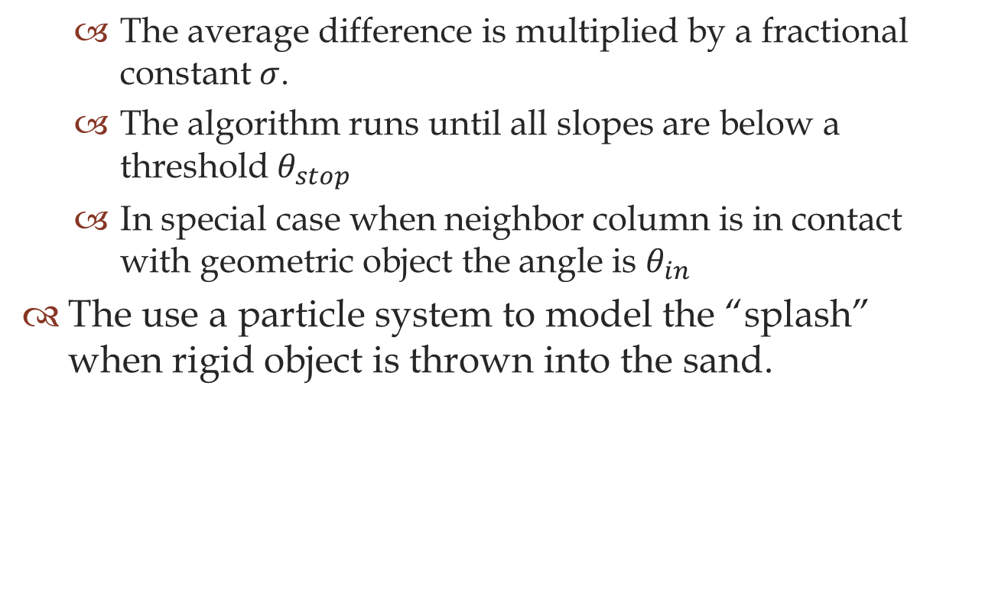
The average difference is multiplied by a fractional constant $σ$.
The algorithm runs until all slopes are below a threshold $θ_{stop}$
In special case when neighbor column is in contact with geometric object the angle is $θ_{in}$
The use a particle system to model the “splash” when rigid object is thrown into the sand.

Slide 37
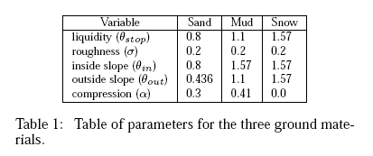
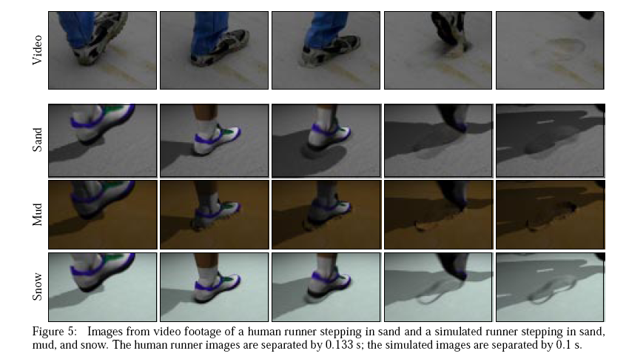

Slide 38
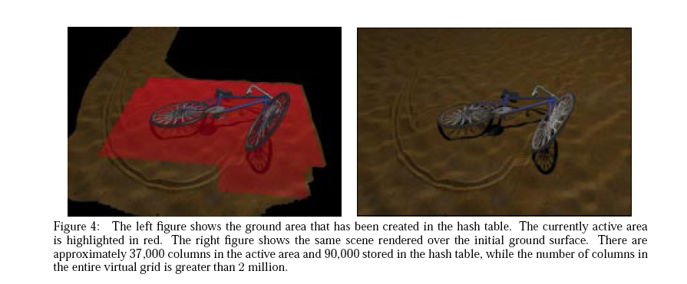

Slide 39
“A Momentum Based Deformation System for Granular Material”
Y.L Zeng , C. I. Tan et al Computer Animation and Virtual Worlds - CASA 2007 Volume 18 Issue 4-5, September 2007 .

Slide 40
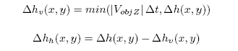
This paper additionally provides impression of objects momentum in deforming the sand terrain.
While determining the displaced material, it takes into count the horizontal and vertical component of velocity.
The vertical component is equally distributed as the previous paper.
The horizontal component is favored to the direction of the velocity.

Slide 41
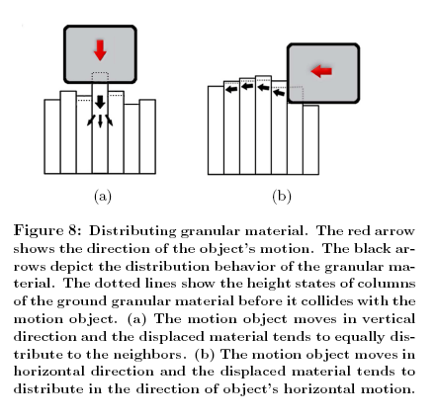

Slide 42
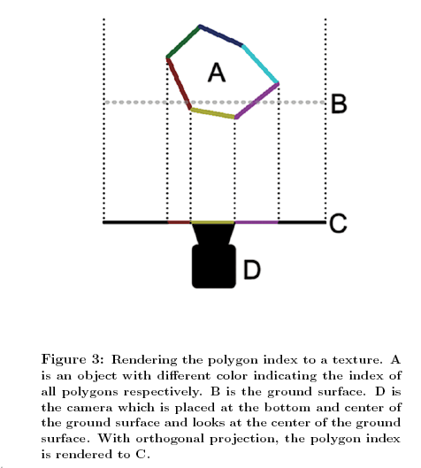

Slide 43
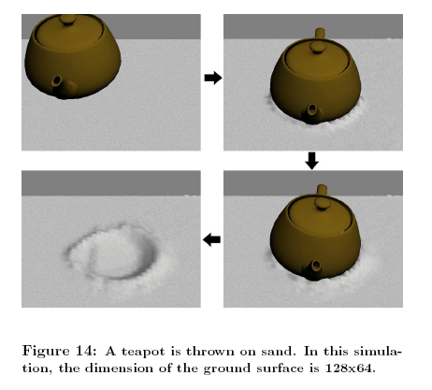
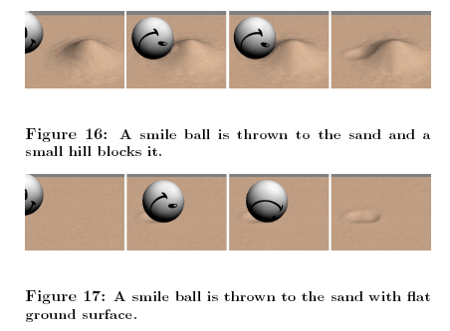

Slide 44
“Virtual sandbox.”
K. Onoue and T. Nishita. Proceedings of the 11th Pacific Conference on Computer Graphics and Applications, pages 252–259, 2003.

Slide 45
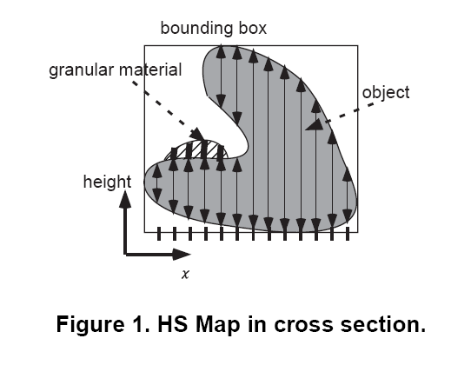

Slide 46
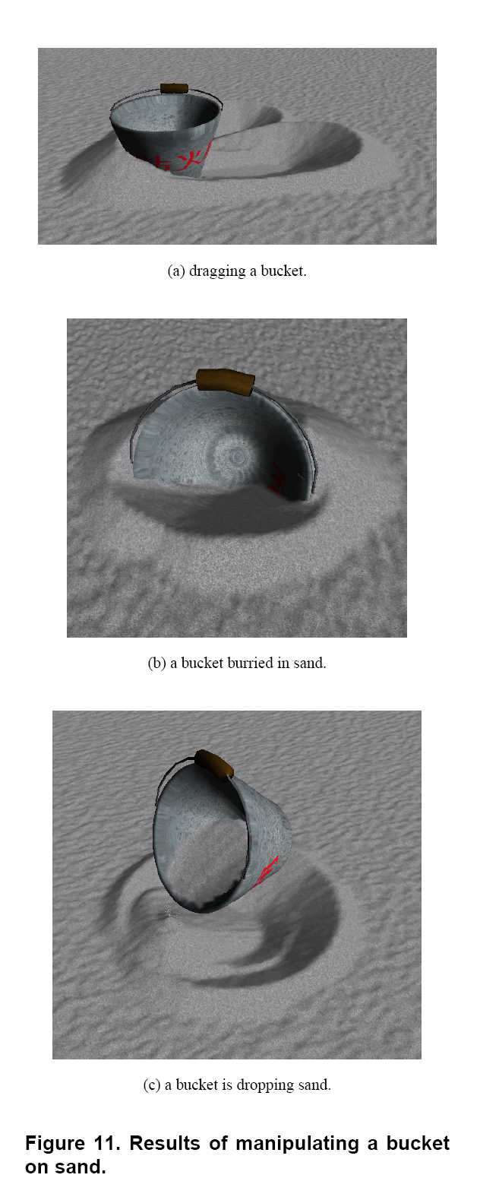

Slide 47
Particle Based Approach
Consider sand granule as simulation unit.
Use newtonian laws of motion to compute interaction between granules
Reduce computation of real physical simulation with some simplifying assumptions
Use special boundary conditions to produce visually correct results

Slide 48
“Globular dynamics: A connected particle system for animating viscous fluids.” Miller, G. and Pearce, A. Computers and Graphics, 13(3):305–309, 1989.

Slide 49
A generic simulation model for any natural object that can be represented as connected set of “blobs” , like lava, mud , slime , oil , salad dressing , meltable solids, sand etc.
They refer to the unit element of the connected particle system as a “Globule”, which literally means “sphere like”
The system is built upon parameterized “soft” collision between globules . The parameters and the final rendering method of the globules define what kind of simulation is being done.

Slide 50
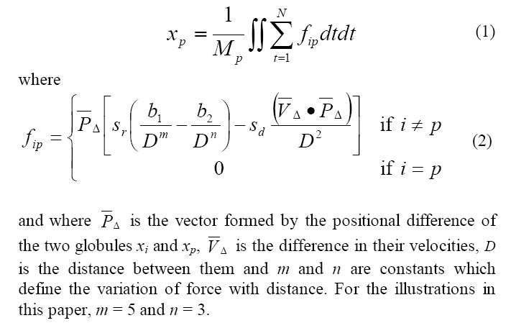
Globule to globule forces
The positional change in the globule over the time step (t) is calculated by double integration of sum of forces acting on the particle:

Slide 51
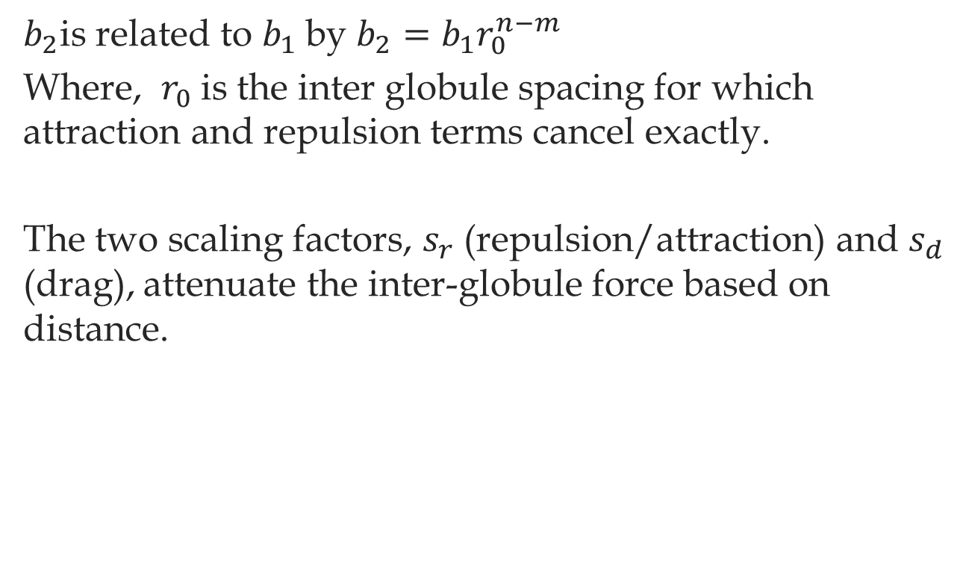
$b_{2}$is related to $b_{1}$by $b_{2}=b_{1}r_{0}^{n−m}$
Where, $r_{0}$ is the inter globule spacing for which attraction and repulsion terms cancel exactly.
The two scaling factors, $s_{r}$ (repulsion/attraction) and $s_{d}$ (drag), attenuate the inter-globule force based on distance.

Slide 52
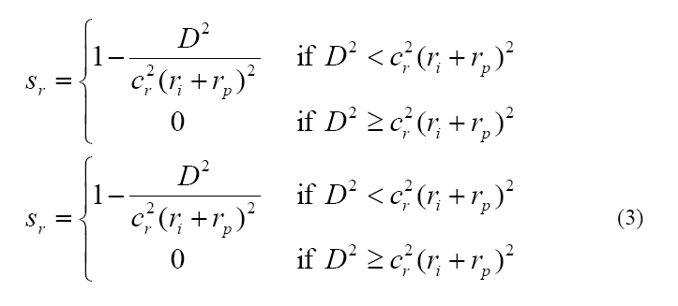
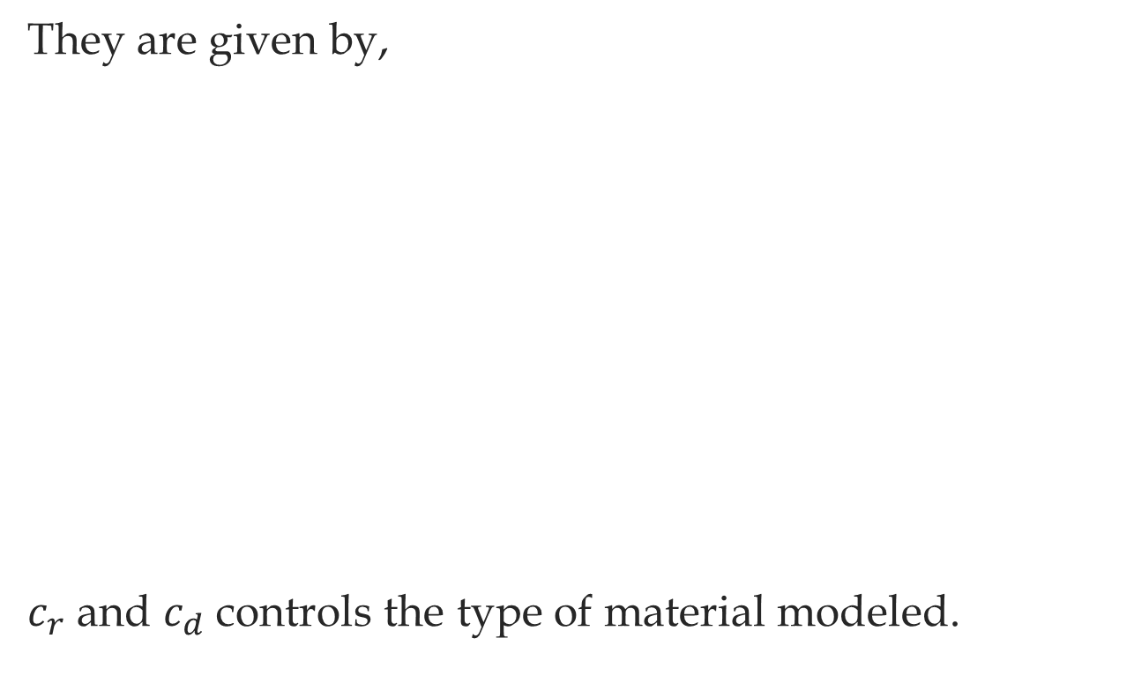
They are given by,
$c_{r}$ and $c_{d}$ controls the type of material modeled.

Slide 53
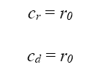
For powder like motion the damping and radial forces are equally attenuated so that damping only occurs when the globules are under compression,

Slide 54
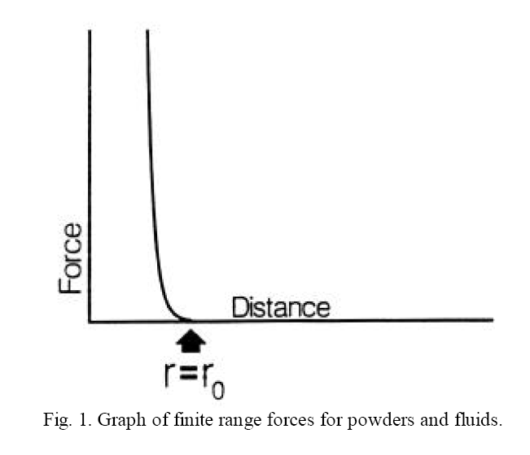

Slide 55
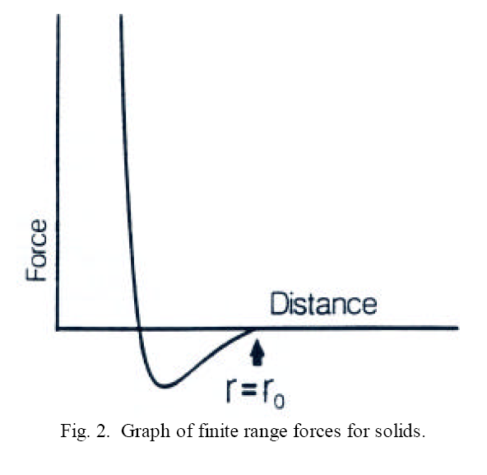

Slide 56
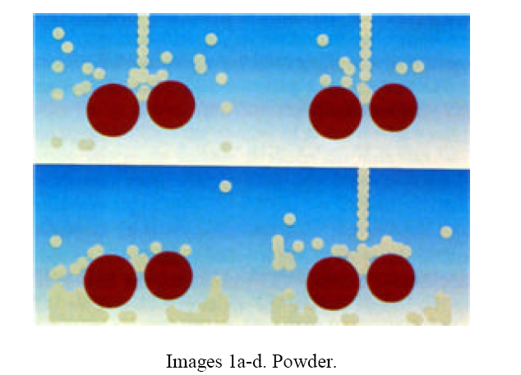
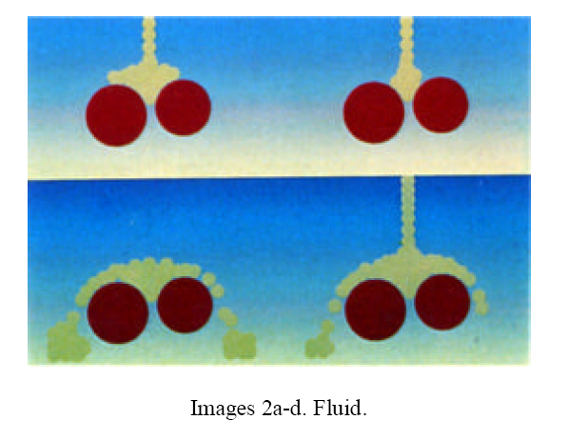

Slide 57
“Particle-based simulation of granular material.” N. Bell, Y. Yu, and P. J. Mucha.
ACM SIGGRAPH/Eurographics Symposium on Computer Animation, 2005.

Slide 58
Use the similar physical behavior like previous paper, but now truly compute motion and interaction for each individual sand granule.
This allows faithful reproduction of wide range of both static and dynamic sand behavior without special case considerations.
Allows rendering of granules directly without help of iso-surface reconstruction.
Can model sparse granule areas.
Can model interaction with rigid bodies seamlessly by modeling the rigid body as a collection of granules on the surface.

Slide 59
Two approaches for computing motion:
Event Driven (ED) or “Hard Sphere” method: Based on the calculation of changes from distinct collisions between particles. Not suitable for dense granular structures with persistent contacts like sand.
Molecular Dynamics (MD) or “Soft Sphere” method: Allows overlap between spheres and repulsion force is a function of the overlap.
They prefer MD method in the paper.

Slide 60
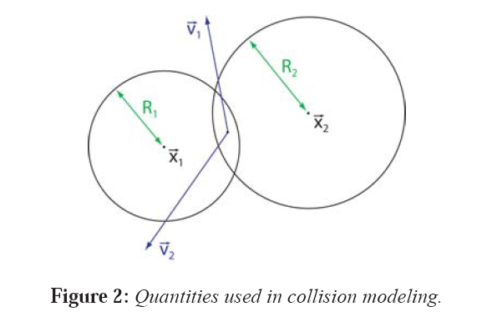
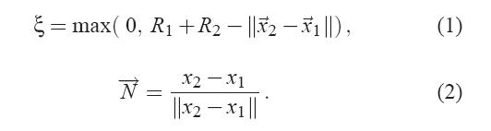
They define overlap $ξ$ as follows,

Slide 61
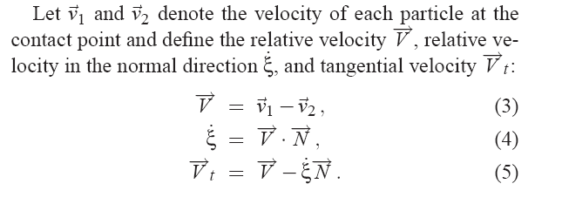

Slide 62
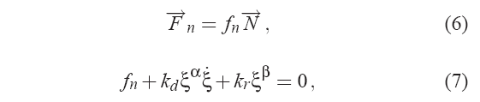
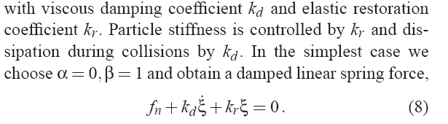
Normal Forces :

Slide 63
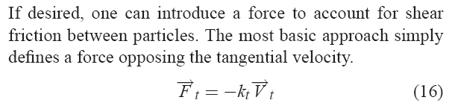
This can only slow the movement in the tangent direction , not stop or reverse it to produce stability to form sand piles.

Slide 64
Introducing further correction to tangential force computation to introduce static coulomb friction complicates simulation even more and make it harder to converge.

Slide 65
To avoid such numerical difficulty, they propose a clever geometric solution, Represent a sand granule not as a sphere, rather approximated rough shape that stabilizes into static state only using normal force computation.

Slide 66
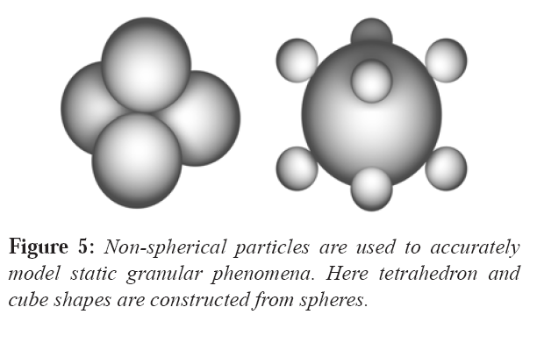

Slide 67
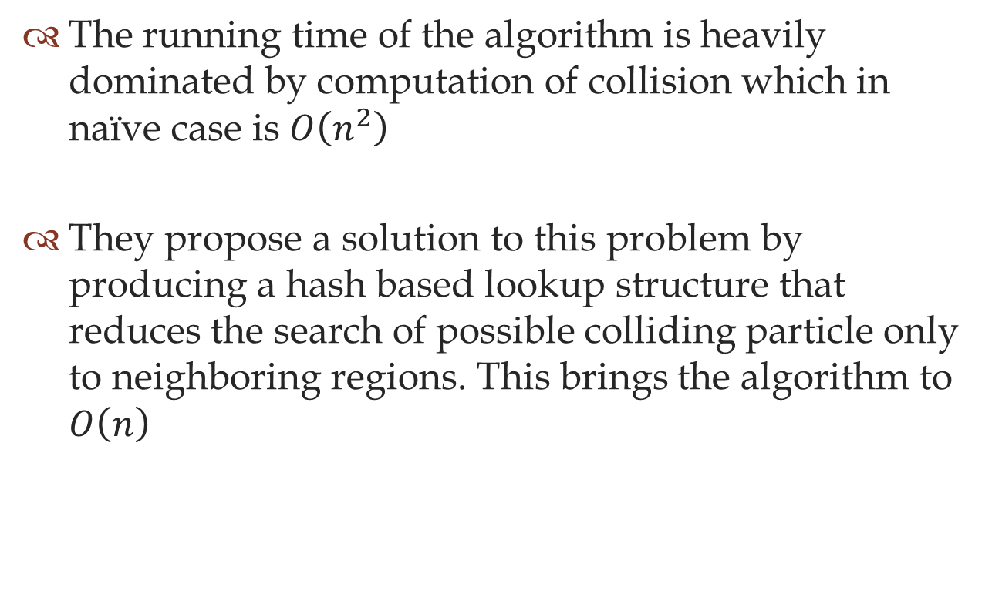
The running time of the algorithm is heavily dominated by computation of collision which in naïve case is $O\left(n^{2}\right)$
They propose a solution to this problem by producing a hash based lookup structure that reduces the search of possible colliding particle only to neighboring regions. This brings the algorithm to $O\left(n\right)$

Slide 68
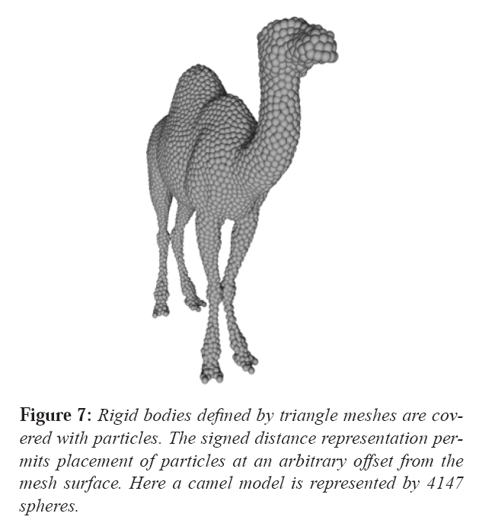

Slide 69
“Real-time animation of sand-water interaction” Rungjiratananon, W., Szego, Z., Kanamori, Y., and Nishita, T. Computer Graphics Forum (Pacific Graphics 2008), volume 27, pages 1887–1893. 2008.

Slide 70
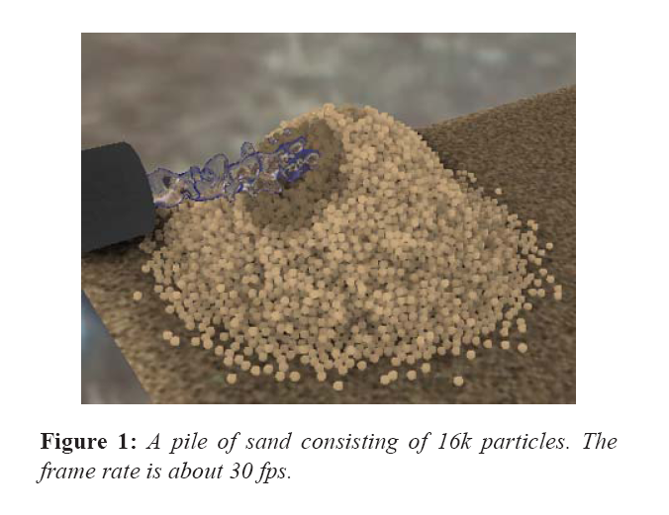

Slide 71
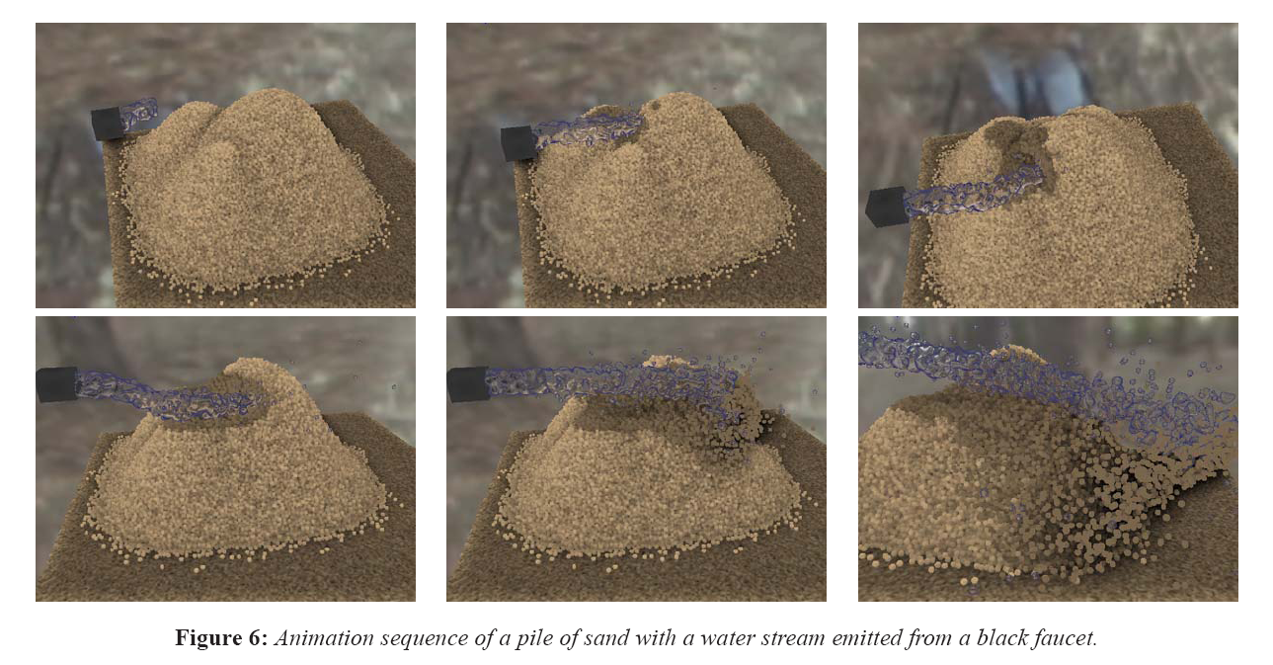

Slide 72
Particle based methods enjoy the advantage of simulating true nature of sand physics. But suffer from the scalability issue of actually computing millions of particle in limited computing resource.

Slide 73
Continuum Method
Rather than simulating each particle of sand, use a low resolution spatial distribution and interpolate the results from that.

Slide 74
Motivation of continuum approach comes from a more generic concept called “Smoothed Particle Hydrodynamics”

Slide 75
“Smoothed Particle Hydrodynamics. “ Monaghan, J. J. Annual review of astronomy and astrophysics, 30(A93-25826 09-90):543–574, 1992.

Slide 76
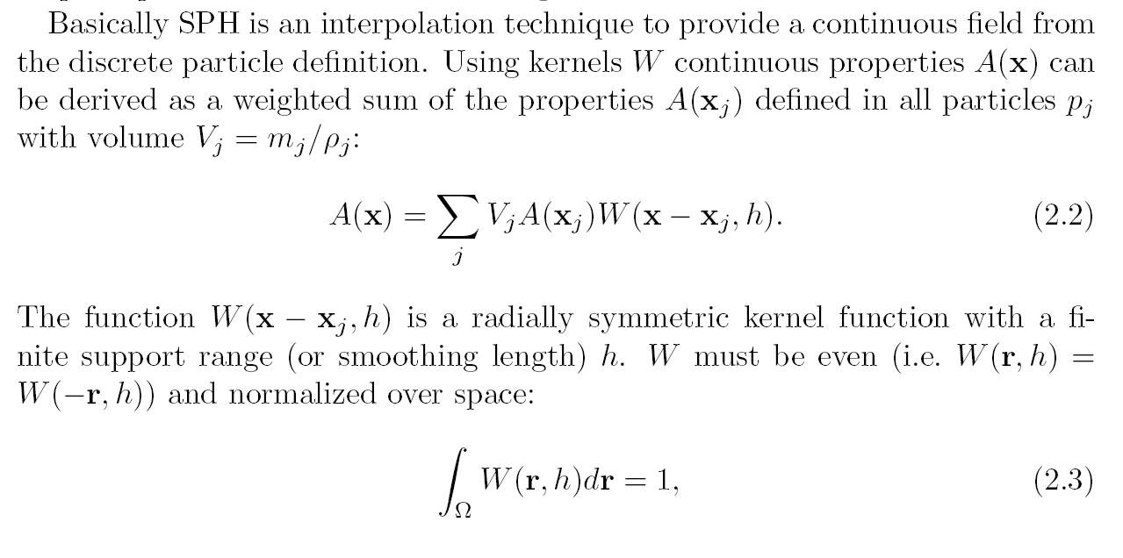

Slide 77
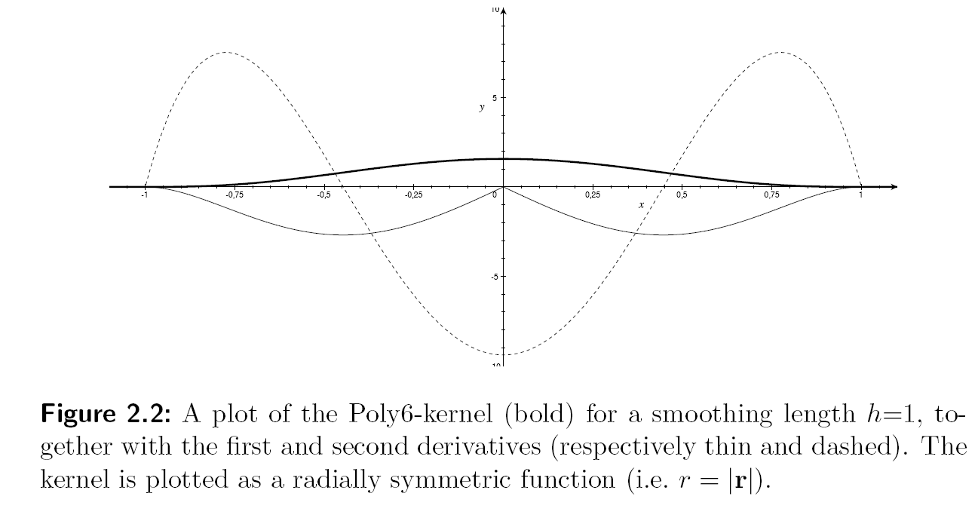
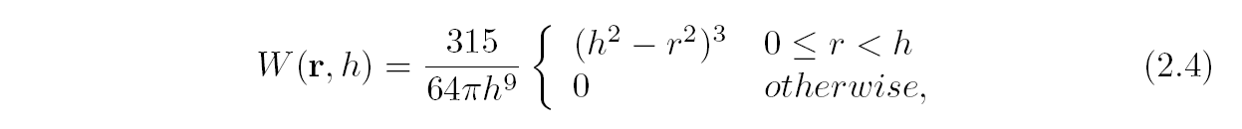

Slide 78
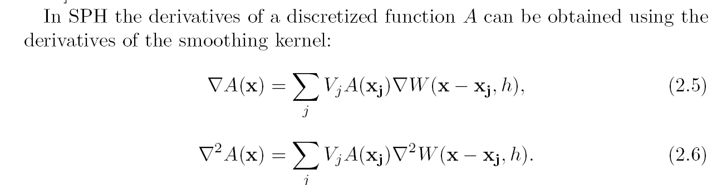

Slide 79
“Animating sand as a fluid.” Zhu, Y. and Bridson, R. ACM SIGGRAPH 2005 Papers, pages 965–972. ACM Press, New York, NY, USA, 2005.

Slide 80
The method of representing natural phenomena as continuum has provided a very useful base of simulating fluid. And for this many fluid solvers are present in the literature that are both visually accurate and also computationally tractable.
This paper provides a way of utilizing a fluid solver to simulate behavior of sand.

Slide 81
The method of fluid simulation can be of two types,
Eulerian Grids: Store velocity, pressure, density etc physical quantity of representing fluid into a fixed grid. Use Eulerian form of navier stokes to simulate transfer of values between grids. Advantages: Simplicity of discretization and solution of the incompressibility condition. Disadvantage: Difficulty with advection part of the equation.

Slide 82
Particle based method: Exemplified by SPH, uses lagrangian form of Navier Stokes to calculate interaction forces on particles. Advantage: Handles advection with natural accuracy. Disadvantage: Difficulty handling incompressibility condition. Problem with non-uniform particle spacing.

Slide 83
With this view, they present a new fluid simulation method with hybrid approach.
Here they combine the two approaches, using particles for basic representation and for advection, but auxiliary grids to compute all the spatial interactions (e.g. boundary conditions, incompressibility, and in the case
of sand, friction forces).

Slide 84
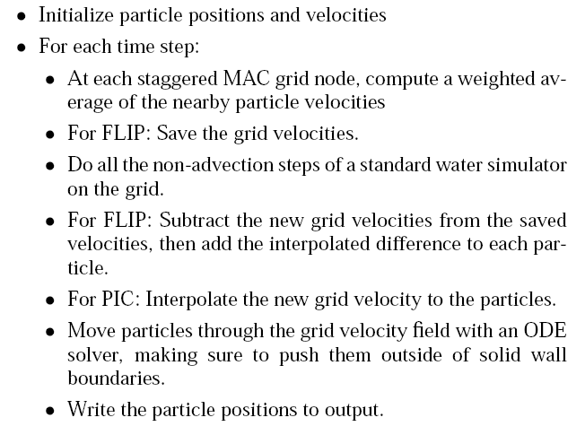
They adapt Particle-in-Cell (PIC) and Fluid-Implicit-Particle (FLIP) to incompressible flow as follows,

Slide 85
Simplifying Assumptions:
Ignore the nearly imperceptible elastic deformation at the start of flow from static state.
Assume the pressure required to make the entire velocity field incompressible will be similar to the true pressure in the sand. This means, with this assumptions we cannot simulate the hourglass. But for other cases , it doesn’t hamper the visually correct behavior of sand.
Thus the domain can be decomposed into regions which are rigidly moving and the rest where we have an incompressible shearing flow.

Slide 86


Yield condition
Where $φ$is the friction angle.

Slide 87

Frictional stress in flow

Slide 88


Slide 89

Cohesion
Even though sand is considered cohesion free, introduction of a very small amount of cohesion improves the result to build a stable sand pile.

Slide 90


Slide 91
“Mixing fluids and granular materials.” Lenaerts, T. and Dutr´e, P. Computer Graphics Forum, 28(2):213–218, 2009b.

Slide 92


Slide 93

Provides SPH based lagrangian method of simulating sand which facilitates mixture of different type of materials.

Slide 94


Slide 95
“Simulation of high-resolution granular media.” Aldu´an, I., Tena, ´A., and Otaduy, M. A. In Proc. of Congreso Espa˜nol de Inform´atica Gr´afica. 2009.

Slide 96
Simulate internal and external forces of granular materials at two different scales.
The computationally expensive internal granule forces are simulate at a spatially large scale.
Less expensive external forces are simulated at spatially fine scale.

Slide 97

Simulation of LR particles
Each particles is a ‘rigid composite particle’ as in [BYM05]
Each particle follows laws of rigid body dynamics [WB01]
Use euler method for integrating velocities. The time step is bounded by the resolution of particle system.
Normal forces are computed from rigid body collision.

Slide 98
They compute shear force for dynamic friction. Static friction is handles by composite granules.

Slide 99

HR particles :
HR particle is generated each time LR guide particle is added to the system.
Using pre-computed distribution within LR particle sphere will introduce visual anomalies like “clumps” in sparse particle areas.

Slide 100


Interpolation of internal Granule Behavior:
Up sample by interpolating the velocity field of the LR guide particles.
Identify sparse and non-sparse region using influence sphere.
In case of sparse region, utilize only external force.
In case of non-sparse region, use distance based weighted velocity interpolation,

Slide 101


